Slide 1
Corporate Retreat Plan
Prepared for new horizon
By Sudipta nanda, Venkata Alekhya Varapula, Ashique Nawaz Chowdhury

Slide 2

‘New Horizon’ Corporate Retreat - Introduction
01
Step away from day-to-day activities and focus on the big picture
02
Learn about new innovations and achievements within the firm
03
Create a closer link between the various cross-functional teams
04
Take a break from work and engage in some relaxation activities

Slide 3
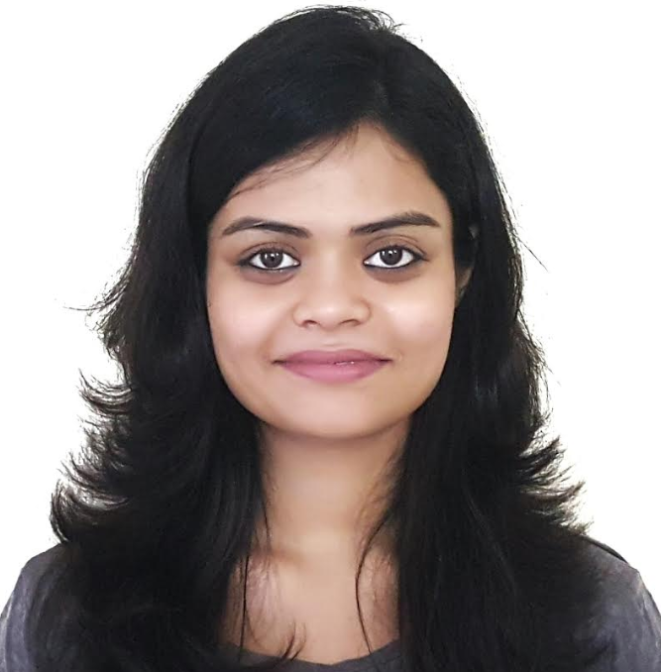



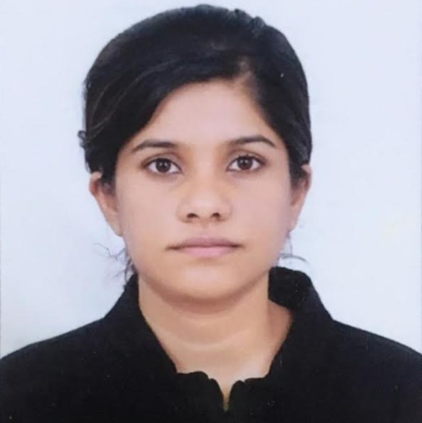


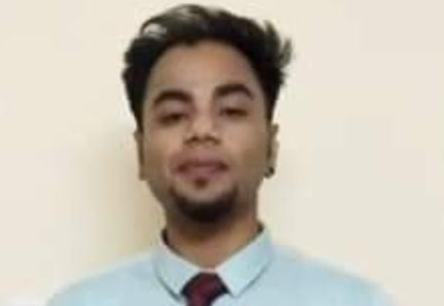
Teams
Project Team
Support Teams
Sudipta Nanda
Gwen Stacy
Scott Mayer
Jennifer Law
Steve Murphy
Finance Manager
Travel Coordinator
Lead Admin
Lead HR
Project Manager
Steering Committee
Venkata Alekhya Varapula
Risk Manager
Alex Hogan
Ramesh K
Sophia Chen
Director of Analytics
Director of IT
CFO
Ashique Nawaz Chowdhury
Lead Consultant

Slide 4

Team Communication
Project Kick-off meeting: 4th May, 2020
Align on scope and preliminary budget
Onboard teams and assign responsibilities
Align on event dates and attendee number
Future Meetings
Bi-Weekly catch up within project and support team
Bi-monthly status update and progress review with Steering committee
As needed meetings for brainstorming, auditing and risk mitigation
Guiding Principles
Encourage communication and collaboration
Over-communication instead of under-communication

Slide 5







Project Charter
Project Overview
Project Scope
New horizon is planning to organize a “3 day” corporate retreat from August 15th (in 2 months from date) for the C/D suite members (50 members) of the firm in order to improve organizational alignment and discuss the “5 year” vision of the firm
Define day level retreat activities
Coordinate with program leads and guest speakers
Coordinate logistics such as travel, venue booking etc.
Milestones
Milestones | Completion Date
Kick off | May 4th , 2020
Finalize requirement (Location, Amenities, Cost etc.) | May 11th , 2020
Finalize retreat activities and related logistics (AV, Stage setup, activity booking etc.) | May 21st , 2020
Finalize meal planning and co-ordination with vendor | May 21st , 2020
Book venue and pay deposit | June 5th, 2020
Final date to RSVP | June 29th , 2020
Event Day 0 Preparations | July 21st, 2020
Event Day | July 22nd – July 24th 2020
Project Budget
Base budget: $200,000
Buffer budget: $40,000
Project Teams
Core Team:
Project Manager
Project Team
Administrators
Travel Coordinator
Steering Committee
Support Team:
Finance/Legal Advisor/HR
Risks
Assumptions
Logistics and cost of accommodating 50 C/D Suite members
“Attendee” availability during the event dates

Slide 6
Work breakdown Structure (WBS)
Corporate Retreat
Requirement Definition
Venue Selection
HQ/Corporate
Event Attendance
Location setup
Event Day Planning
Objectives
Location
Amenities
Size/Attendees
Budget
Site Visit
Venue Selection
Contract
Deposit
Insurance/Liabilities
Budget Allocation
Marketing Material
Invitations
RSVP
Materials
Transportation
Banner/Booth Design
Booth setup
Booth teardown
Staffing plan
Guest Speakers
Entertainment
Room/Venue Scheduling
Technology
Meal Planning

Slide 7


Project cost estimate (1/3)
 | WBS element | #Units/hrs | Cost per Hr | Subtotal | WBS level total | %Total
 | Requirement Definition |  |  |  | $1,250 | <1%
 | Project Team | 15 hours | $50 | $750
 | Steering committee | 5 hours | $100 | $500
 | Venue Selection |  |  |  | $104,000 | 52.8%
 | Project Team | 50 hours | $50 | $2,500
 | Conference Halls | 2 days | $20,000 per day | $40,000
 | Hotel Rooms (50 rooms) | 3 days | $150 per day | $22,500
 | Wi-Fi/Internet | 2 days | $500 per day | $1,000
 | AV and Equipment cost | 2 days | $5000 per day | $1,000
 | Fun activities | 1 day | $500 per person | $25,000
 | Lunch | 2 days | $20 per person | $2,000
 | Formal Dinner (Day 0 and Day 1) |  | $50 per person | $5,000
 | Bon-Fire and Casual Dinner (Day 2) |  | $100 per person | $5,000

Slide 8


Project cost estimate (2/3)
 | WBS element | #Units/hrs | Cost per Hr | Subtotal | WBS level total | %Total
 | Budget Allocation |  |  |  | $1,250 | <1%
 | Project Team | 5 hours | $50 | $250
 | Steering committee | 5 hours | $100 | $500
 | HR/Finance Team | 10 hours | $50 | $500
 | Event Attendance |  |  |  | $53,500 | 27%
 | Design marketing material, invitations, posters etc. | 50 hours | $100 | $5,000
 | Travel Coordinator | 50 hours | $50 | $2,500
 | Book air transportation for guests |  |  | $25,000
 | Coordinate with guest speakers | 20 hours | $50 | $1,000
 | Send RSVP invite to attendees | 10 hours | $50 | $500
 | Book ground transportation for guests |  |  | $15,000
 | Coordinate with teams for event day programs and presentations | 50 hours | $50 | $2,500
 | Print and collect materials, presentations, posters, handouts etc. for event days | 40 hours | $50 | $2,000

Slide 9
Project cost estimate (3/3)
 | WBS element | #Units/hrs | Cost per Hr | Subtotal | WBS level total | %Total
 | Location Setup |  |  |  | $2,000 | <1%
 | Project Team | 20 hours | $50 | $1000
 | Admin Team | 20 hours | $50 | $1000
 | Event Day Management |  |  |  | $9,000 | <1%
 | Project Team | 80 hours | $50 | $4,000
 | Admin Team | 100 hours | $50 | $5,000
 | Contingency Funds |  |  |  | $25,650 | 15%
 | Total Project Cost Estimate |  |  |  | $196,750

Slide 10
RACI Matrix
 | Project Team | Project Manager | Steering Committee | Travel Coordinator | Administrators | Finance/HR
Requirement Definition | R | A | C |  | I
Venue Selection | R | A | C | I | R | I
HQ/Corporate Decisions |  | R | A |  |  | A
Event Attendance | R | A | C | R | R
Location Setup |  | A | I |  | R
Event Day Planning | R | A | I |  | R
R = Responsible
A = Accountable
C = Consulted
I = Informed

Slide 11
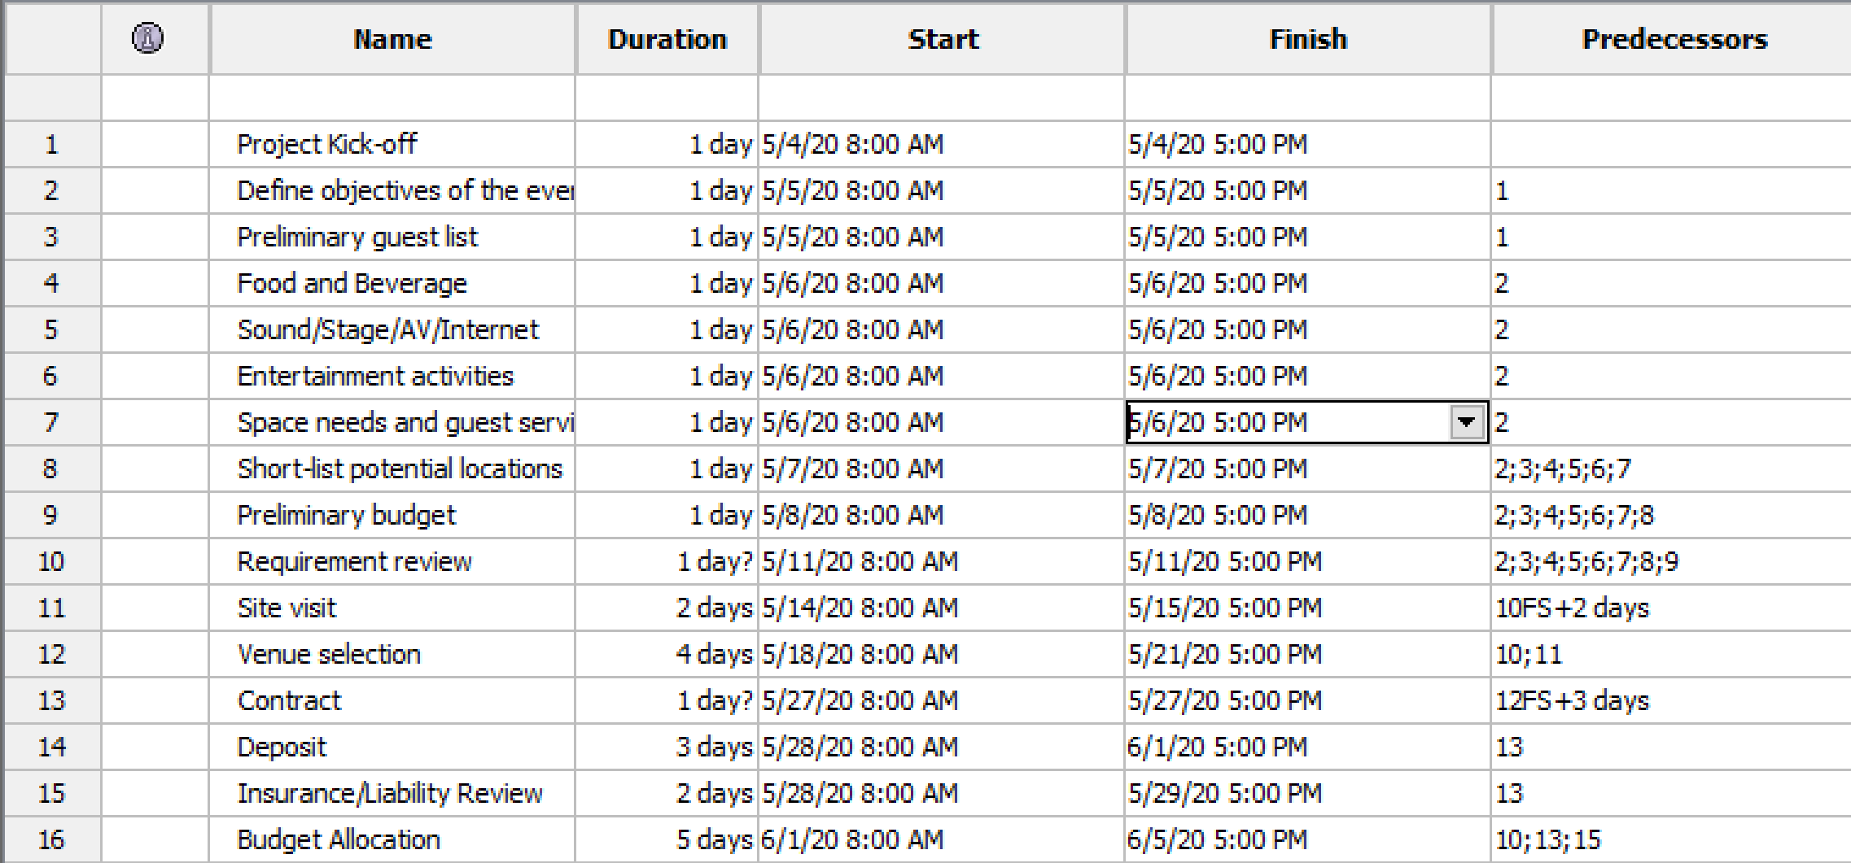
Project Timeline (1/2)

Slide 12
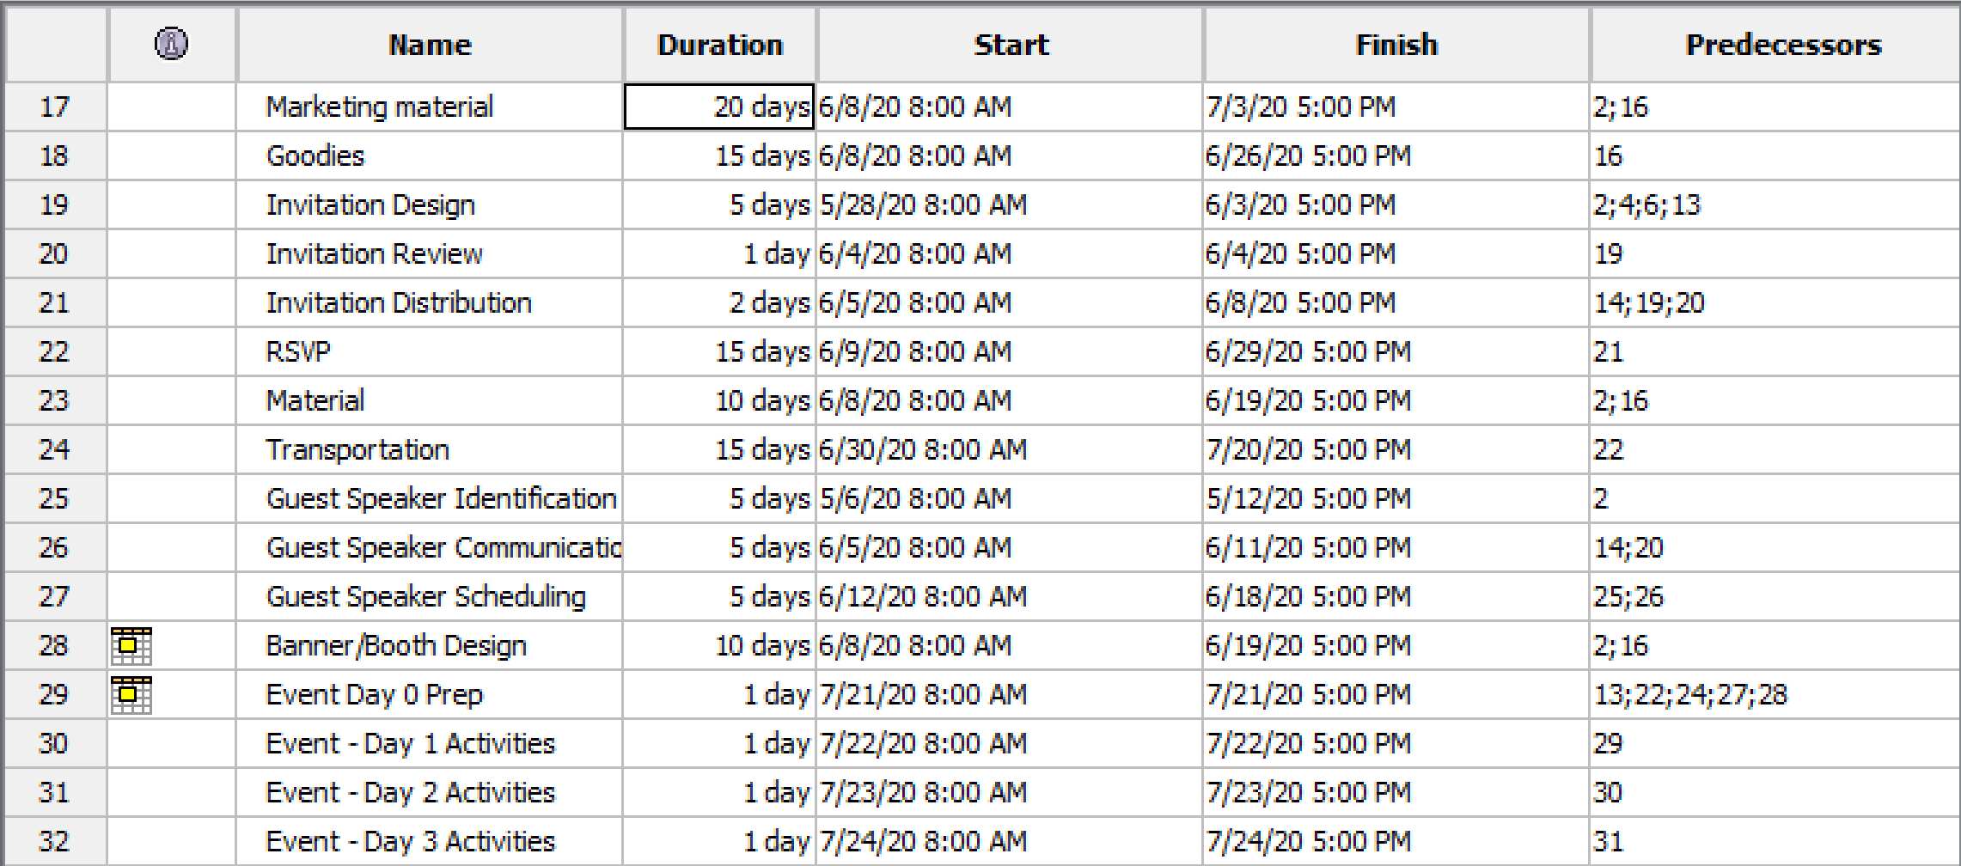
Project Timeline (2/2)

Slide 13
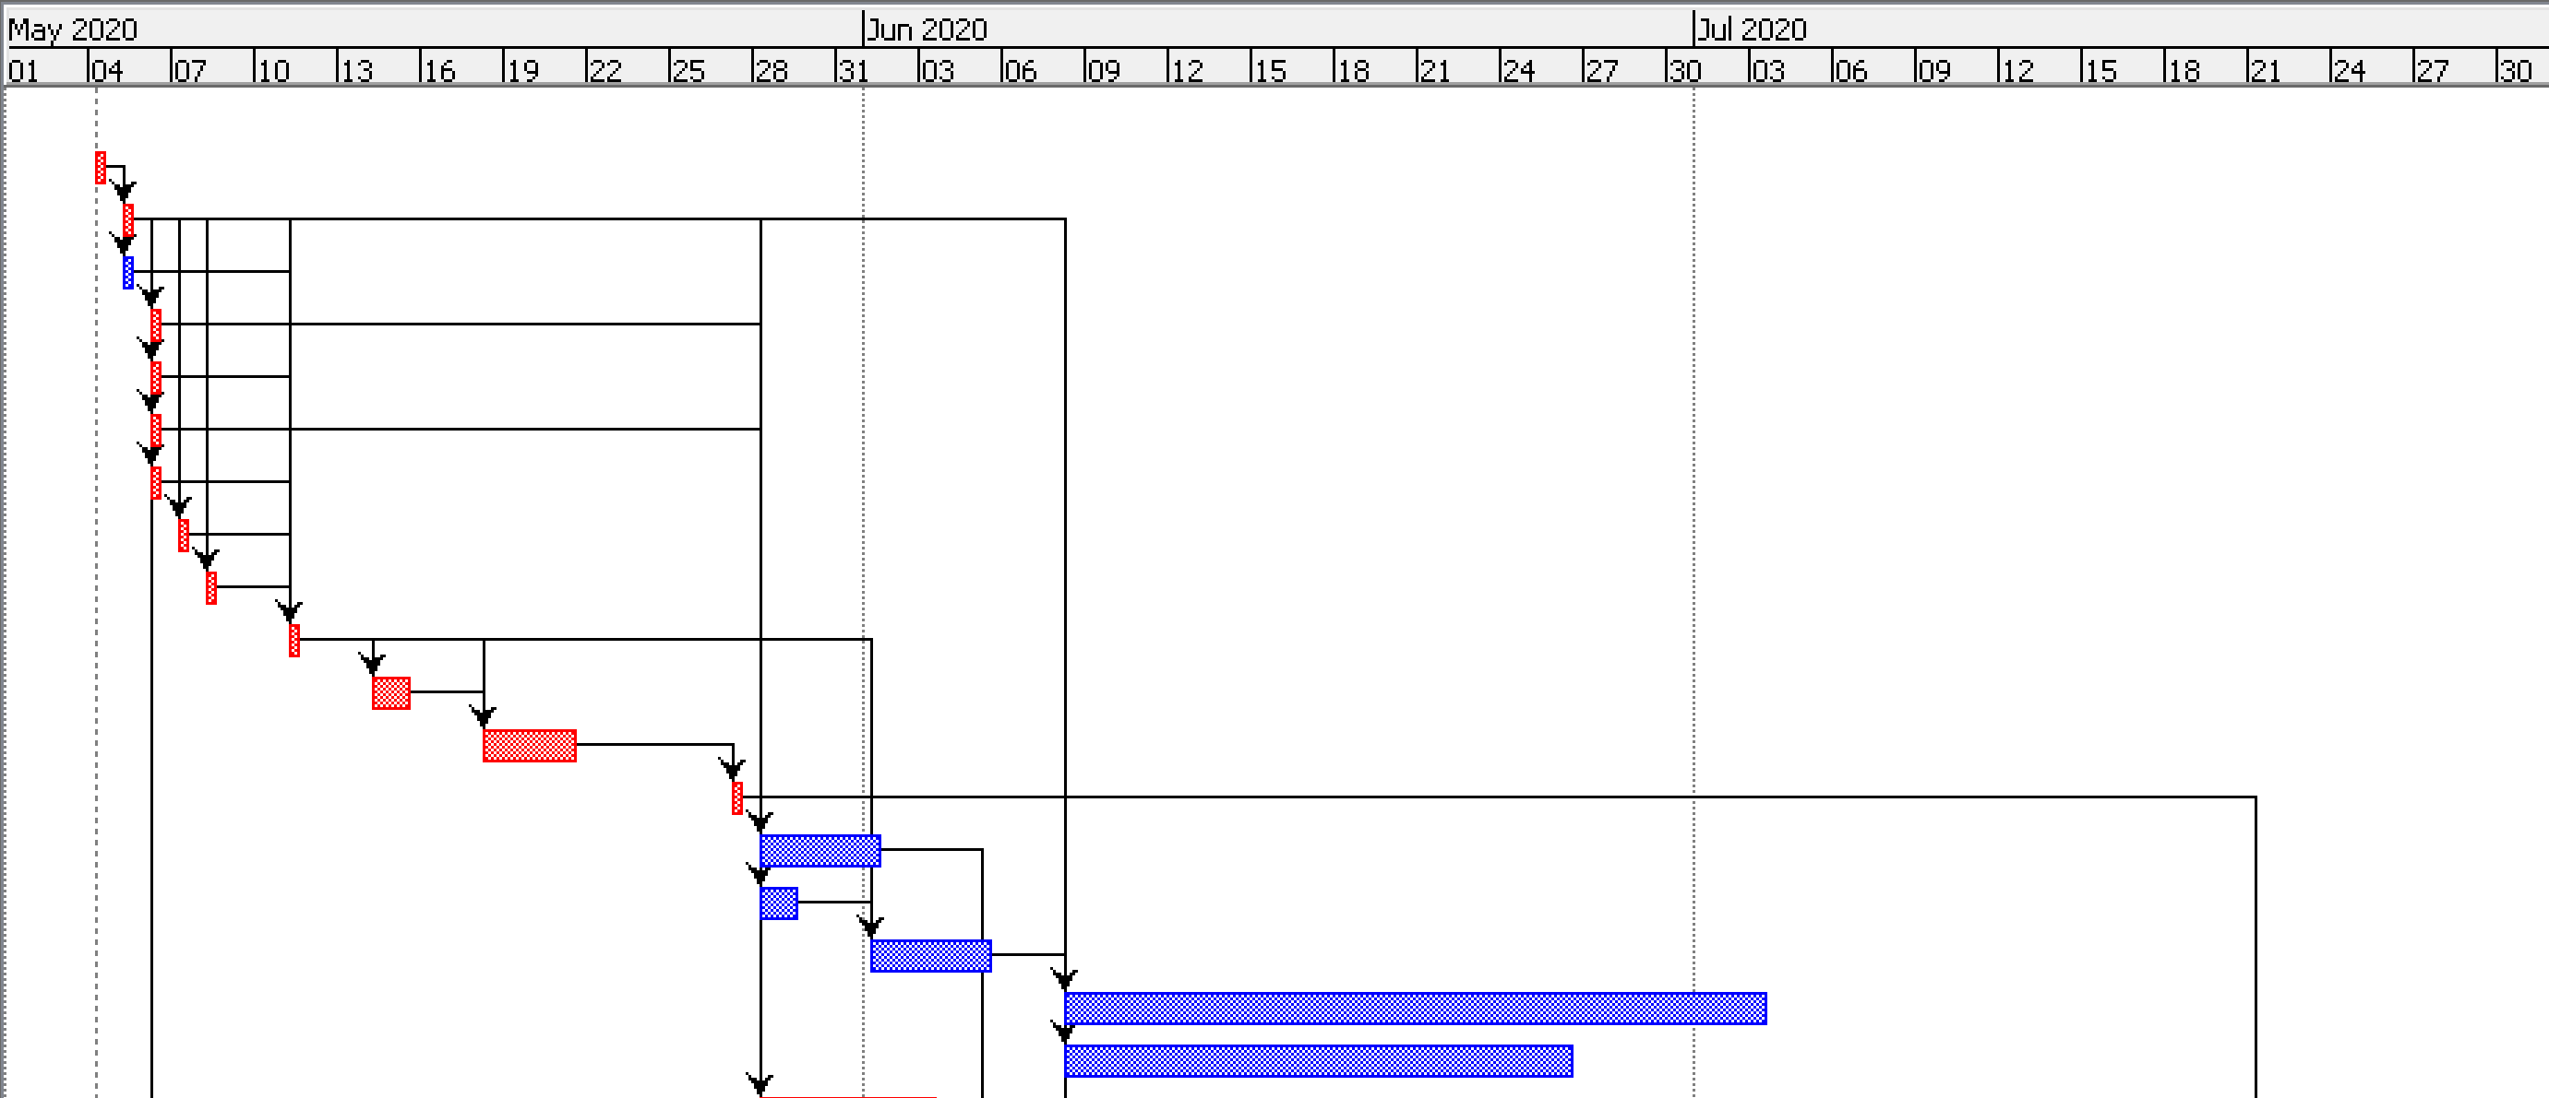
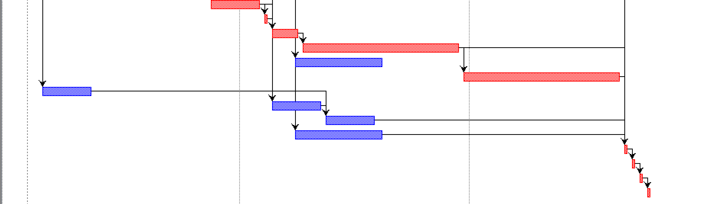
Gantt Chart

Slide 14
Risk Matrix (1/3)
Risk Event | Occasion | Response | Mitigation Plan | Contingency | Trigger | Responsibility
Delay in review of event requirements | Requirement review | Mitigation, Avoiding | Advance communication | Review with single member of steering committee | Steering committee busy on review day | Project Manager
High cost of amenities | Venue Selection | Mitigation, Accept | Alternate sources for amenities | Amenities can be rented locally | High demand for venue | Administrators
Unavailability of desired venue | Venue Selection | Mitigation | Prepare venue options | Distribute across multiple venues | High demand for desired venue | Project Manager
Limited resources for creative and design | RSVP and Event Design | Mitigation | Out-source design work to multiple external vendor | Leverage internal project teams to support with C&D | Event sessions require significant C&D support | Project Manager
Unable to support Dietary restrictions | Meal planning | Mitigation, Avoiding | Source special diets from local vendors | Transportation to local restaurants during meals | Hotel does not support specific needs | Administrators
Unpredictable weather | Event days | Accept |  | Alternate indoor locations/activities |  | Administrators; Venue vendor
Flight cancellations | Event day 0 | Mitigation, Accept | Last minute alt. flight bookings | Online video conference for key speakers | Weather, airline delays | Travel Coordinator
Medical Assistance | Event days | Mitigation, Avoiding | Ensure availability of medical personal at venue | Identify list of local hospitals and physicians |  | Administrators; Venue vendor

Slide 15
Risk Matrix (2/3)
Risk Event | Occasion | Response | Mitigation Plan | Contingency | Trigger | Responsibility
Potential fire hazards | Event days | Mitigate, Avoid | Work with venue to verify their fire response | Familiarize with extinguisher locations; Identify local fire department |  | Venue vendor
Loss of sensitive firm data | Event days | Avoid | Work with hotel security; Remove all firm related material post event | Ask presenters to avoid sensitive data on presentations and posters/handouts | Non-firm related personnel at site; misplaced sensitive content | Project Manager; Administrators
Session cancellation due to unavailability of Guest speaker | Event days | Mitigate, Accept | Identify substitute speakers from within the firm | Alternate “fun” activities to fill the slot | Guest speaker unavailability | Project Manager
Transport and traffic management | Event days | Mitigate, Avoid | Schedule arrivals one day in advance; plan activities within short distance; factor past traffic delays in route |  | Traffic incident | Administrators
Poor Time Management | Event days | Mitigate, Avoid | Keep 5 min transition buffer between sessions; Assign person to check time |  | Session overruns/delayed starts | Administrators

Slide 16
Risk Matrix (3/3)
Risk Event | Occasion | Response | Mitigation Plan | Contingency | Trigger | Responsibility
Delay in poster/banner printout | Marketing material | Mitigate, Avoid | Identify alternate resources for printouts | Use in-office printer and hand drawn art |  | Administrators
Last minute changes in presentation styles | Event day | Mitigate | Back up resources to mitigate unforeseen demand |  | Presenters made last minute changes to the method of presentation (E.g. poster to ppt) | Project manger, Adminisrators

Slide 17
Progress Report – Executive Summary
Status Date | Project Name | Stakeholders | Previous Week | Current Week
1st June 2020 | Corporate retreat | Steering Committee | On Track | On Track
Accomplishments - Last Week |  | Planned – Next 2 Weeks
Reviewed event requirements with Steering Committee Finalized venue location and verified against requirements Received price quote and paid location deposit Estimated budget required for event and share with finance for budget allocation Identified Guest Speakers for events |  | Finalize budget allocation for the event Start preparing marketing material and RSVPs Co-ordinate with event session owners create content
Open Questions and Decisions |  | Risks
Key Decisions: All event “fun” activities will be held within the retreat venue or within 5 miles of location Theme for the event will be “Innovation” |  | No risks have been identified so far

Slide 18
Wrap-Up Closure Checklist
Description of Task | Status | Date Completed | Notes
“Thank-you” notes to speakers, sponsors and presenters | Yes | July 28th 2020
Work with production company/videographer for event photos/videos | Yes | July 30th 2020
Pay any outstanding invoices | Yes | July 27th, 2020
Send attendees a post event survey | Yes | July 24th , 2020
Analyze post-event survey results | Yes | July 28th , 2020
Compile survey results for Steering Committee | Yes | August 1st,2020
Upload event photos/videos on company website | No
Team debrief: Discuss and document what worked and what didn’t | No
For incentivized surveys and quizes, notify winners and send prizes | No

Slide 19
Learnings from the project
Certain smaller guest needs were not accounted for in Project plan. Project plan should have accounted for hour level plan for event days. E.g.
Special room for any guest wishing to take calls during event
Sharing event details on the name tags to allow guests for easier movement
Back up microphones for audience participation
Better co-ordination for live audience sessions
Better management of event sessions for more engaged participation
Sessions for Day 2 after lunch were long & theoretical causing sub-optimal participation
More live sessions/surveys and “bazar” models

